Slide 1
Mapping Camera Coordinates to a Shutter Coordinate System
MD Rashed Rahman

Slide 2
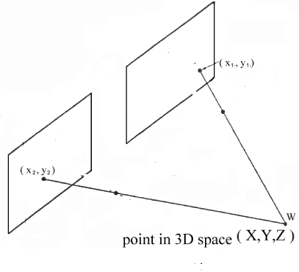
Problem Formulation
Pi cam (r x c)
Finding out the coordinates of a particular location in a shutter (real world) coordinate system based on the information from a camera system
Shutter (R x C)

Slide 3
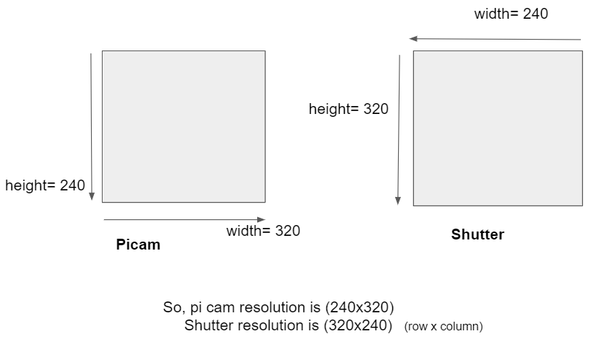
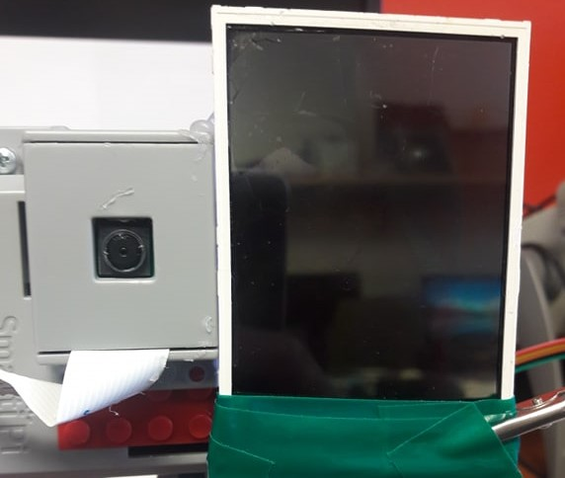
Feasibility Study with a setup
Convert the coordinates from (240 x 320) to (320 x 240)
Finding the pixel differences dx and dy
PiCam(240 x 320)
Shutter(320 x 240)

Slide 4
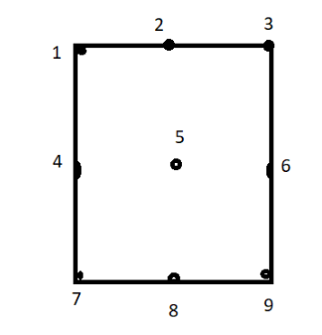
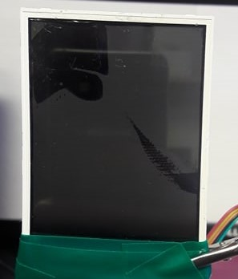
Selecting Calibrating Points
Shutter(320 x 240)
LCD Shutter Resolution (320x240)

Slide 5
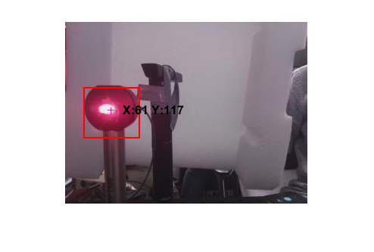
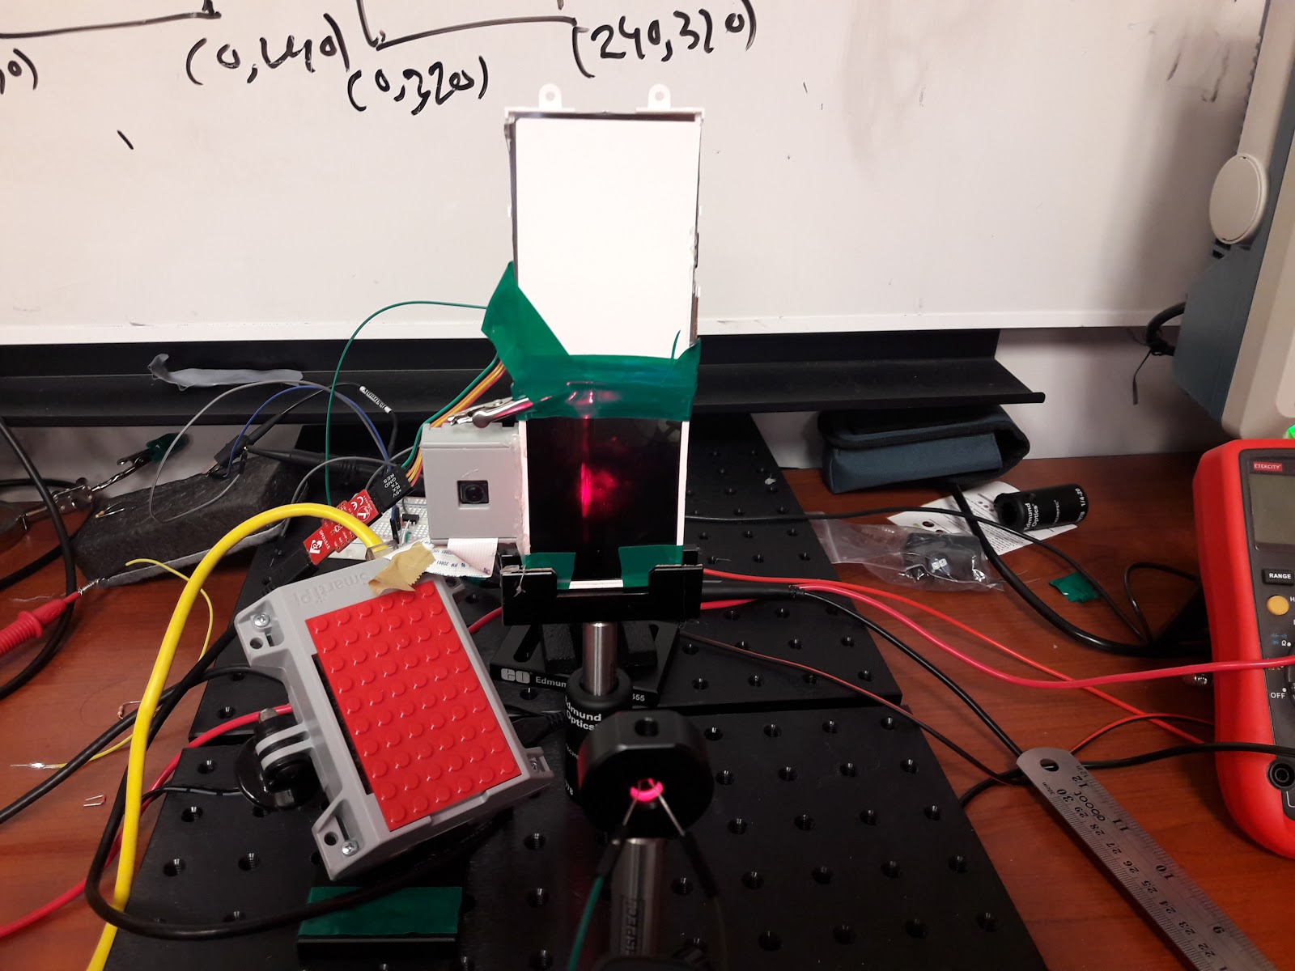
Focusing Centre of the Shutter
In pixel coordinates system, for 240x320: (117,61)
In 320x240 , it would be (156,46)
dx= 160-156= 4 dy= 120-46= 74
point-5 (Centre of Shutter)

Slide 6
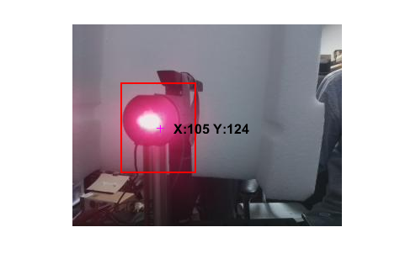
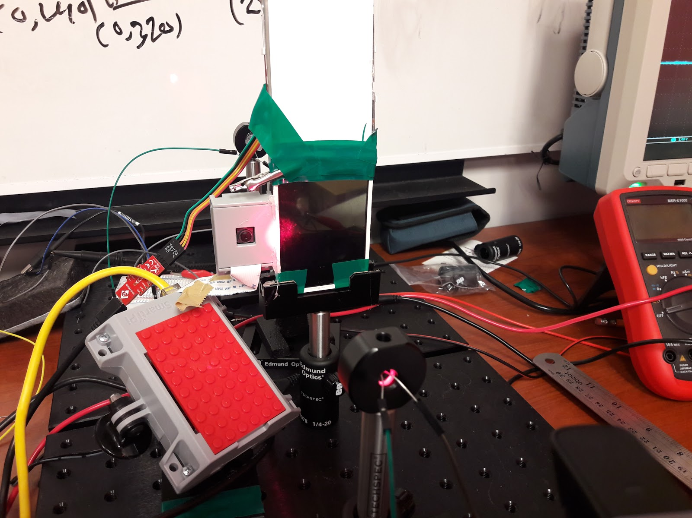
In pixel coordinates system, for 240x320: (124,105)
In 320x240 , it would be (166,79)
so , that would be (166+4, 79+74)= (170,153)
point-4

Slide 7
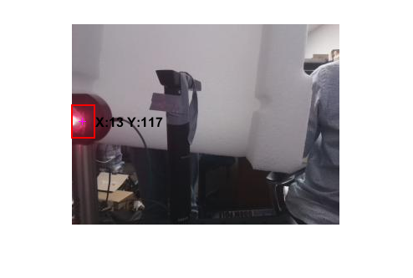
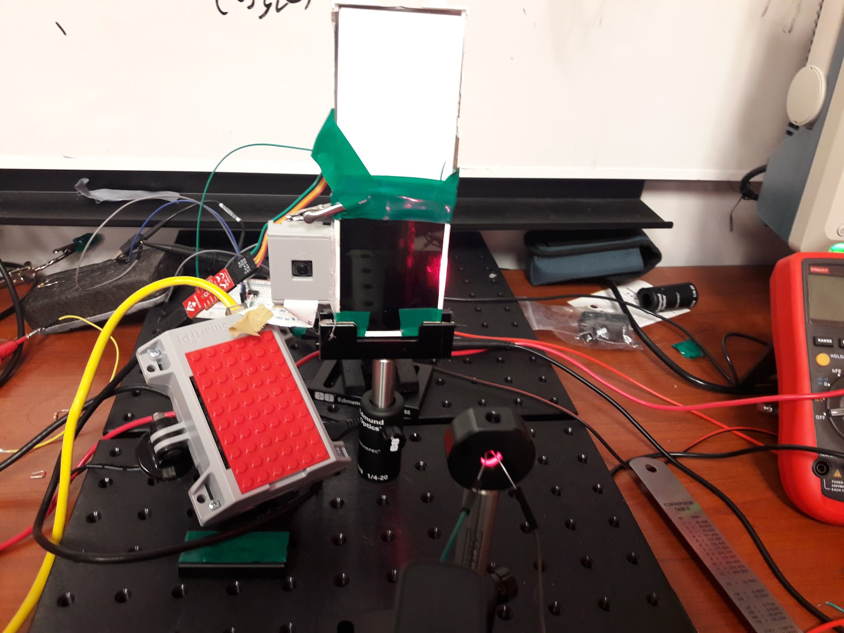
In pixel coordinates system, for 240x320 : (117,13)
In 320x240, it would be (156,10)
so , that would be (156+4, 10+74)= (160,84)
point-6

Slide 8
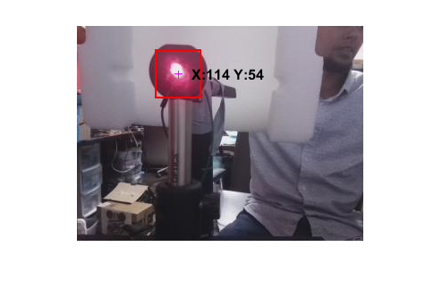
In pixel coordinates system, for 240x320 : (54,114)
In 320x240, it would be (72,86)
so , that would be (72+4, 86+74)= (76,160)
Point 1

Slide 9
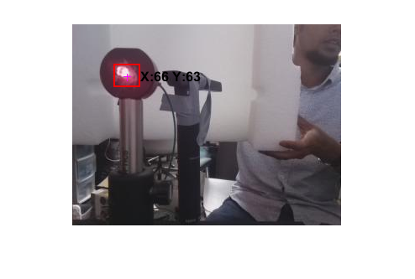
In pixel coordinates system, for 240x320 : (63,65)
In 320x240, it would be (84,50)
so , that would be (84+4, 50+74)= (88,124)
Point 2

Slide 10
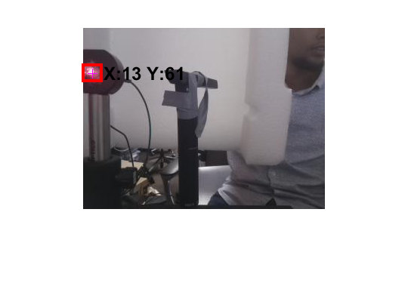
In pixel coordinates system, for 240x320 : (61,13)
In 320x240, it would be (82,10)
so , that would be (82+4, 10+74)= (86,84)
Point 3

Slide 11
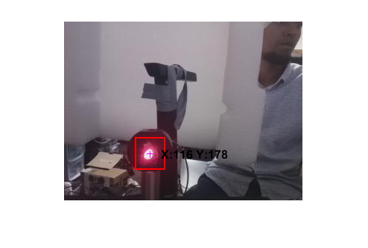
In pixel coordinates system, for 240x320 : (178,116)
In 320x240, it would be (238,87)
so , that would be (238+4, 87+74)= (242,161)
Point 7

Slide 12
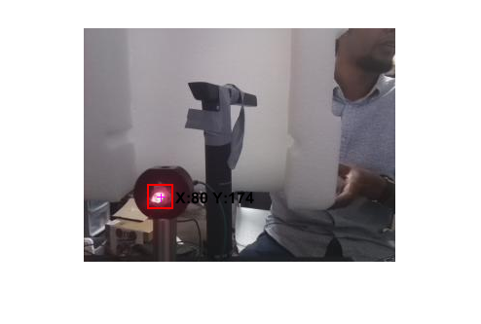
In pixel coordinates system, for 240x320 : (174,80)
In 320x240, it would be (232,60)
so , that would be (232+4, 60+74)= (236,134)
Point 8

Slide 13
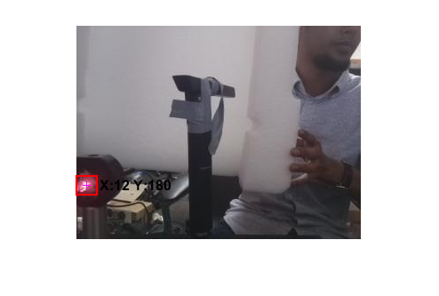
In pixel coordinates system, for 240x320 : (180,12)
In 320x240, it would be (240,9)
so , that would be (240+4, 9+74)= (244,83)
Point 9

Slide 14
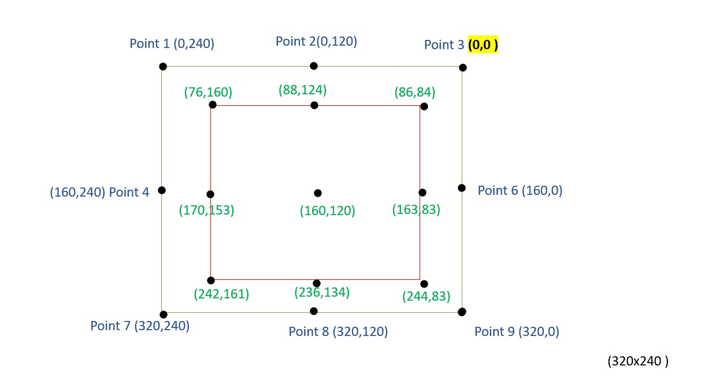
After converting (240x320) pi cam image to (320x240), we get these coordinates for 9 points

Slide 15
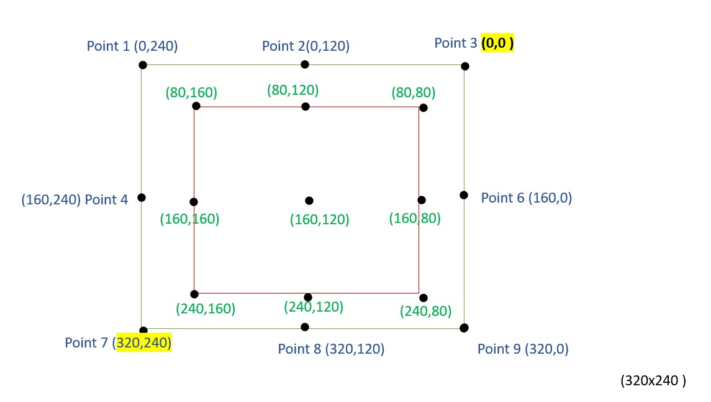
Taking approximation values,

Slide 16
Mapping from 240x320 image to 320x240 shutter
Now, we get a 160x80 resolution, in which these 9 points are verified.
So, the new coordinates equation can be,
X_{s (160x80)} = 80 + X_{s (320 x 240)} / 320 * 160
Y_{s (160x80)} = 80 + Y_{s (320 x 240)} / 240 * 80
Here,
ΔX = 80 [resolution difference along rows]
ΔY= 80 [resolution difference along columns]
Xs and Ys represent number of rows and columns in pixel coordinates
[ X_{s (160x80)} - 80 ]* 2 = X_{s (320 x 240)}
[Y_{s (160x80)} - 80 ]* 3= Y_{s (320 x 240)}

Slide 17
Steps for General Mapping
Convert pi cam image (r x c) to (R x C) shutter image
Find out the pixel difference along X [dx] and Y axis [dy] (Translation vector Tx and Ty)
Calibrate the camera for at least 9 points and get the new coordinates of these 9 points.
Based on this calibration, find out ΔX and ΔY which are resolution difference along rows and columns
Get the new resolution (R’ x C’) for the shutter image
Now, calculate the each coordinates on the shutter image based on this following equation:
X_{s (R’ x C’)} = ΔX + X_{s (R x C)} /R * R’
Y_{s}(_{R’ x C’}) = ΔY + Y_{s (R x C)} /C * C’
X_{s (R x C)} = [X_{s (R’ x C’)} - ΔX ] *R / R’
Y_{s (R x C)} = [ Y_{s}(_{R’ x C’}) - ΔY ]*C / C’

Slide 18
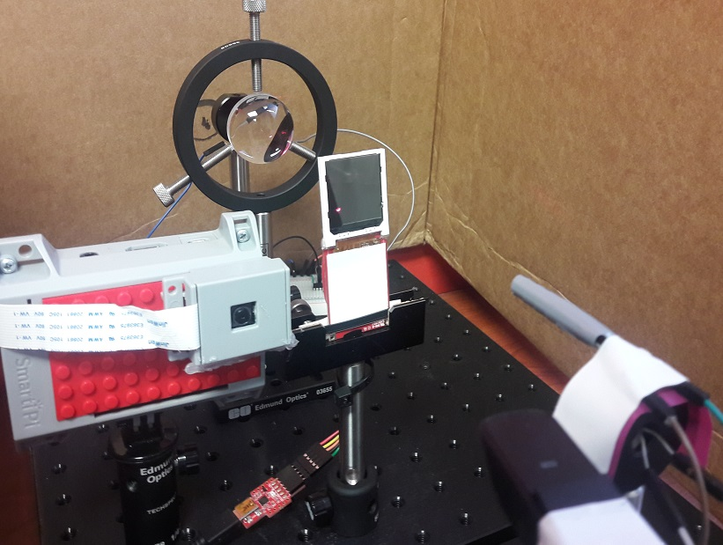
Application in VLC System

Slide 19
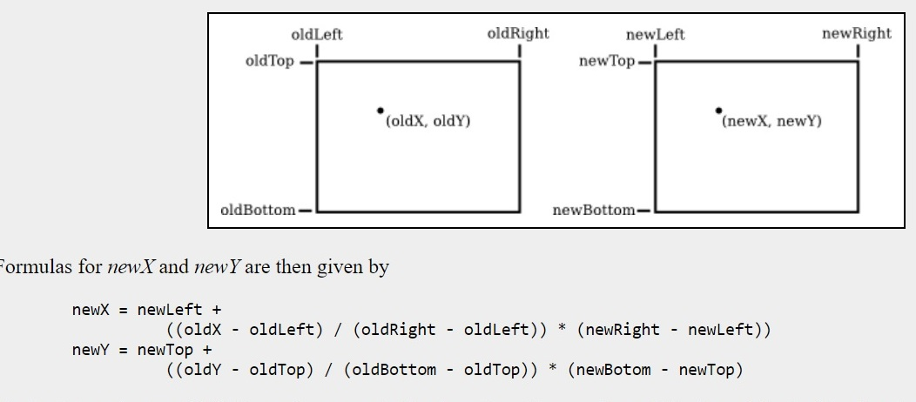
Appendix I
Conversion rule from one resolution to another

Slide 20
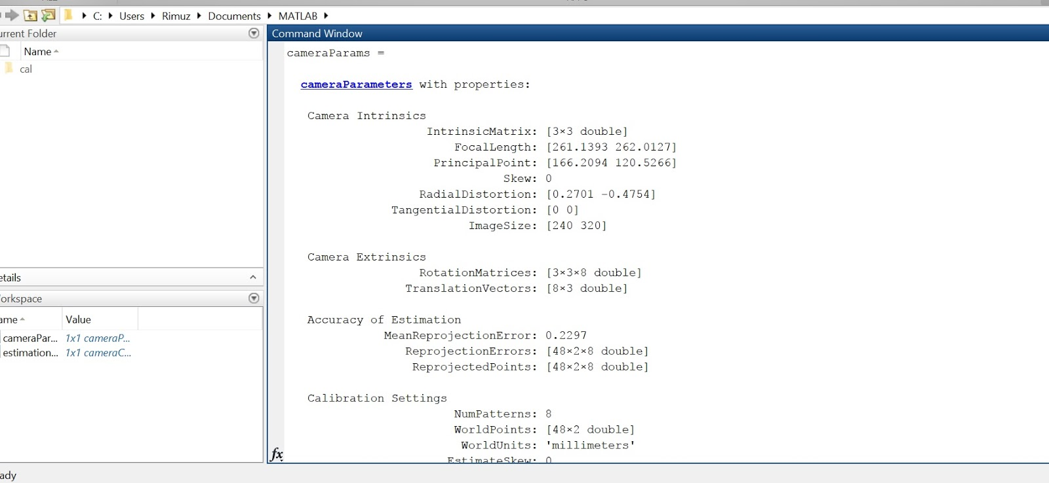
Appendix II
Pi camera Calibration results

